Slide 1
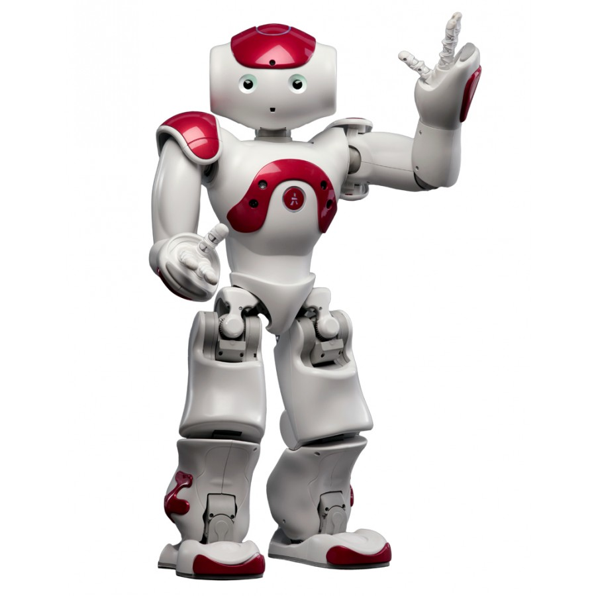
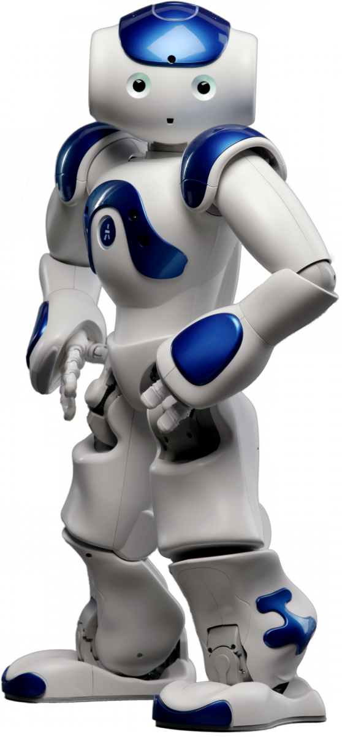
Hello! I’m NAO.

Slide 2
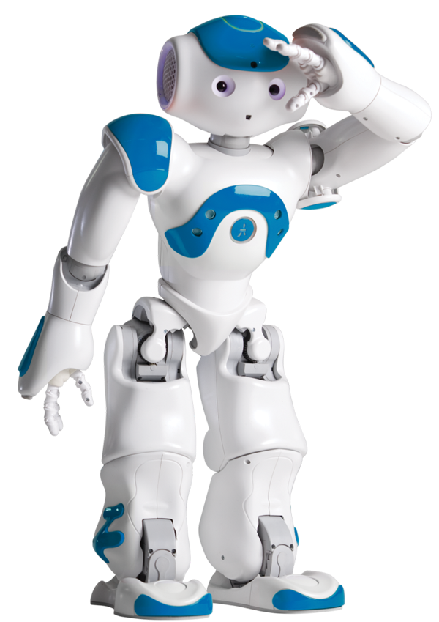
Hello! Who are you?
58 cm tall = 22.8 inches
9.5lbs
Beginning: 2006
Now: 9,000 NAOs across the globe
Feeling : numerous sensors in its head, hands and feet
Hearing and speaking : 4 directional microphones and loudspeakers
Seeing : two cameras
Connecting : WiFi, Ethernet

Slide 3
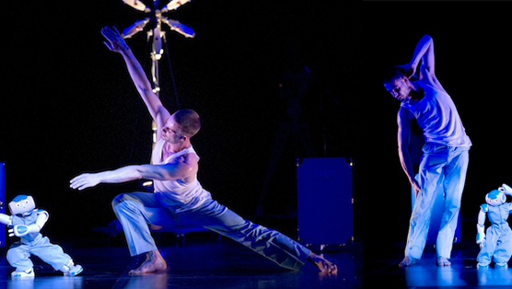
7 NAO joined the "ROBOTS" show company

Slide 4
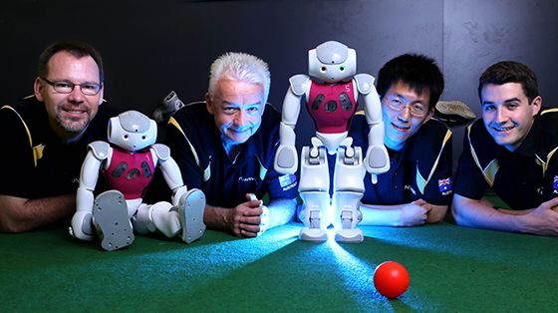
Australian "rUNSWift" team from the University of New South Wales (UNSW) carried off the Standard Platform League cup at the Robocup 2015.

Slide 5
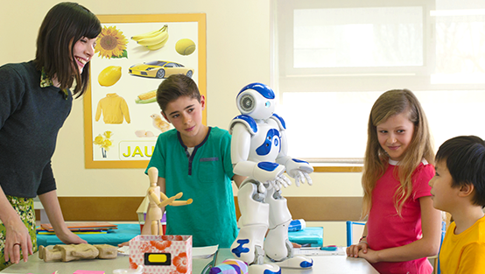
Angelica Lim joined the SoftBank Robotics adventure as an engineer developing emotional applications.

Slide 6
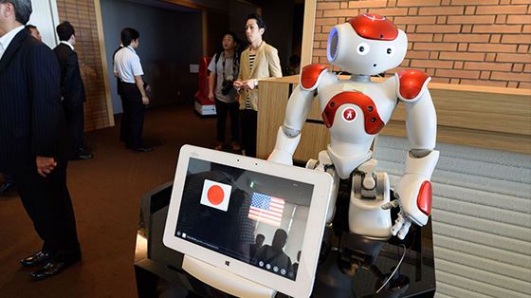
Since July 2015, a new type of hotel has opened in a theme park. NAO welcomes the guests and provides them with information in a variety of languages.

Slide 7
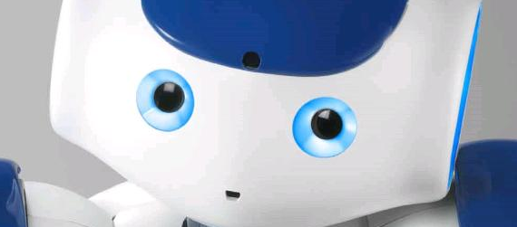
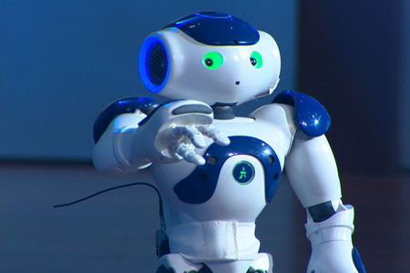
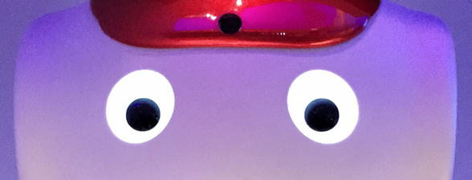
Hello! How are you?
If the eyes are blue swirls, the robot is listening.
When they are green, it understood something and is thinking about it.
Otherwise, it’s not listening!

Slide 8
Tell me about…
Mercury
Venus
Earth
Mars
Jupiter
Saturn
Uranus
Neptune
Pluto
Computers
Something random!
Nao
Say: “Tell me about yourself.”

